Slide 1








Greece STR
market review
2023-25

Slide 2

About the presentation
  Introduction to PriceLabs
  Evolution of the Greek market
  Occupancy, ADR and RevPAR comparison (Countries)
  Occupancy, ADR and RevPAR comparison (Cities)
  Listing contribution by host size

Slide 3








Who is PriceLabs ?
Founded
2014
450K+
listings priced per day
Revenue Management & Pricing for:
150+
integration
Short-Term Rentals (but also):
  Vacation rentals
  Aparthotels (short/medium terms)
  Villas and Chalets
  Boutique Hotels
6 Languages
English, Spanish, French, Italian, Portuguese, German
WINNER
NOMINEE
Employees
HQ: Chicago
Team: US, Brazil, Portugal, India, France, Puerto Rico, Netherlands, Philippines , Bulgaria
Best Ancillary Service Provider Award
Powering Listings with Design and Data

Slide 4



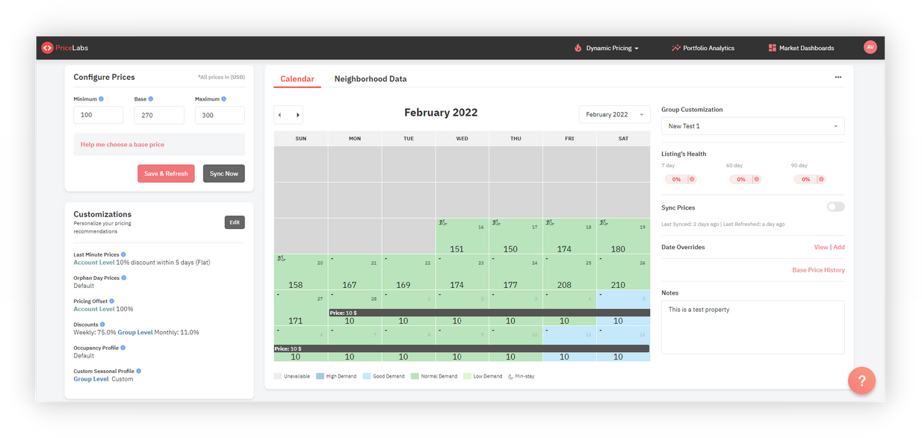

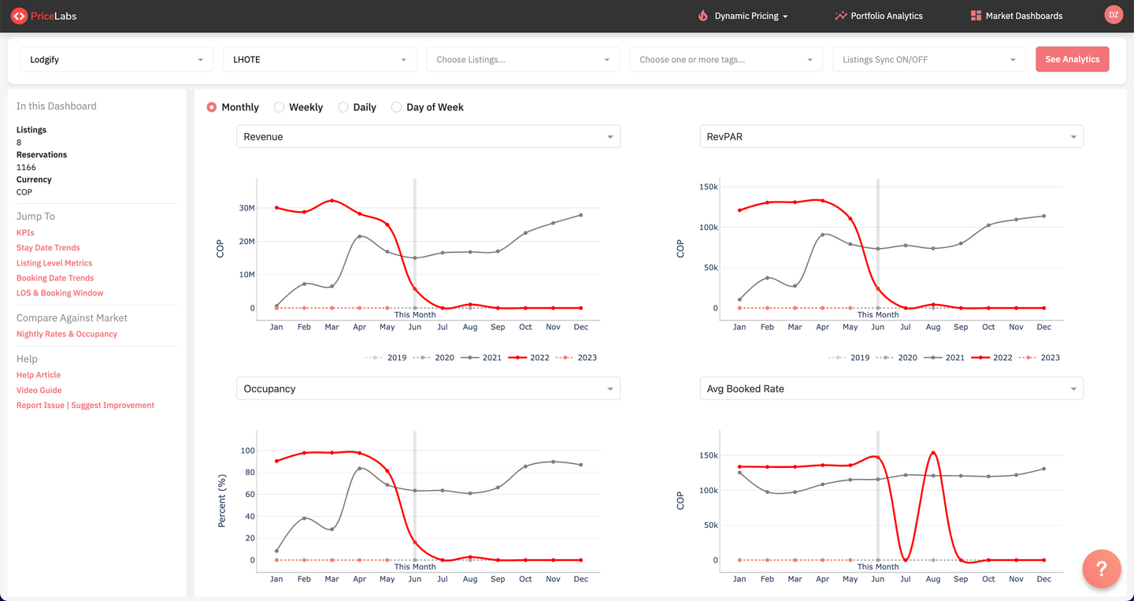
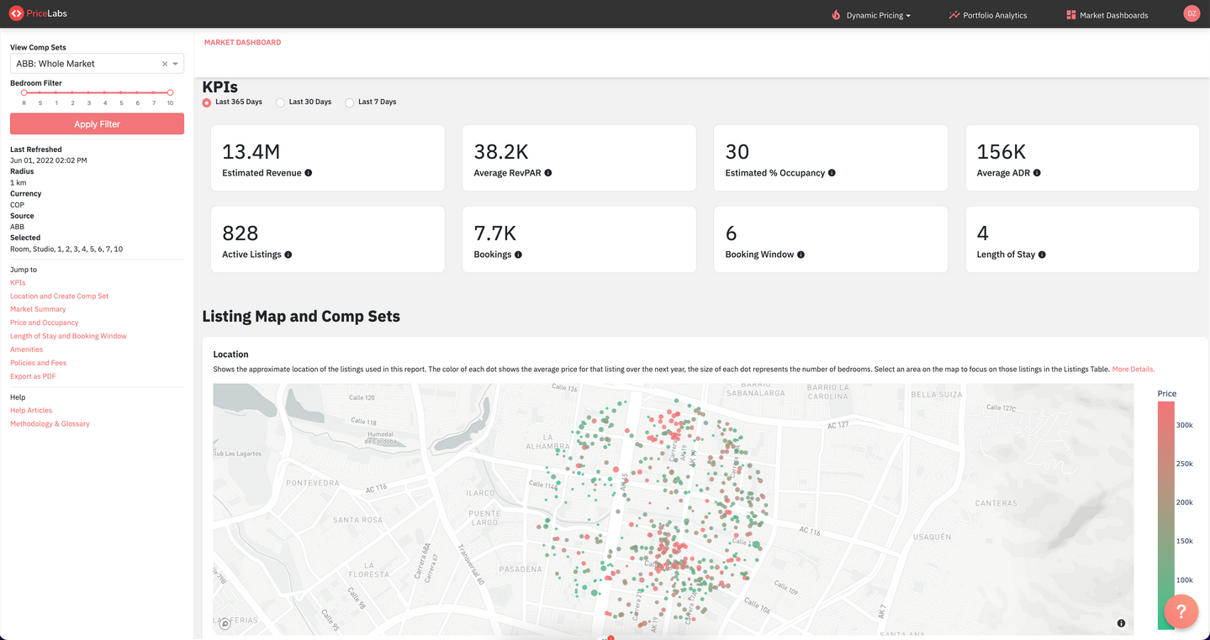
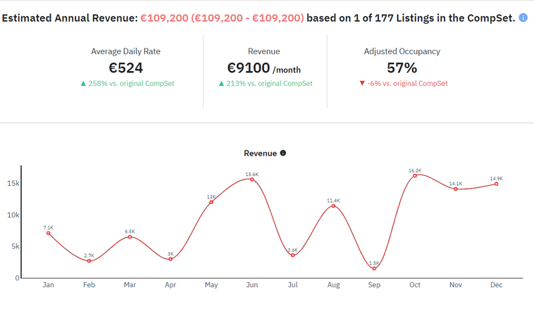
PriceLabs Products
Dynamic Pricing
Portfolio
Analytics
Market Dashboard
Revenue Estimator
Optimize occupancy by automatically varying pricing
Improve decision making through data driven insights
Refine actionables through in-depth market data
Estimate property earning potential using market data

Slide 5

Greece market performance
2023-25

Slide 6
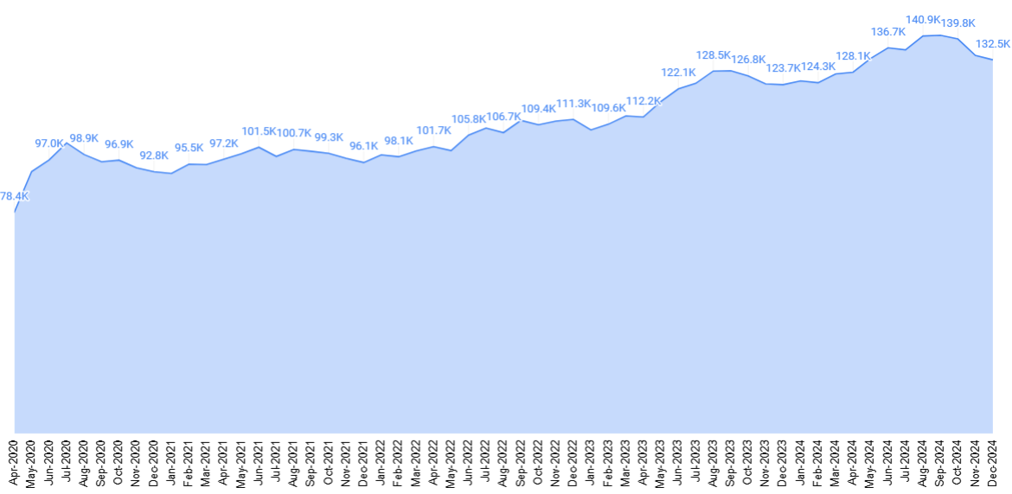
Airbnb listing trends in Greece
11% listing growth in the last 12 months
Average listing count compared: Jan 2023-Dec 2023 vs. Jan 2024-Dec 2024
PriceLabs data, January 2025 (EURO) Excludes private rooms

Slide 7
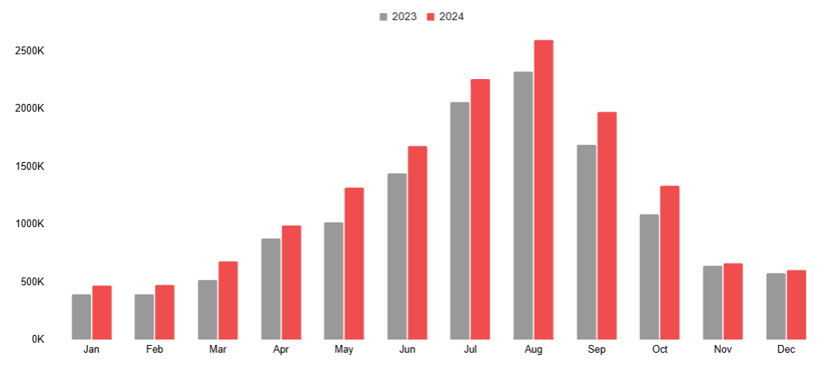
Past booked nights: 2024 vs 2023
Booked nights grew by 16% in last 12 months
PriceLabs data, January 2025 (EURO) Excludes private rooms

Slide 8
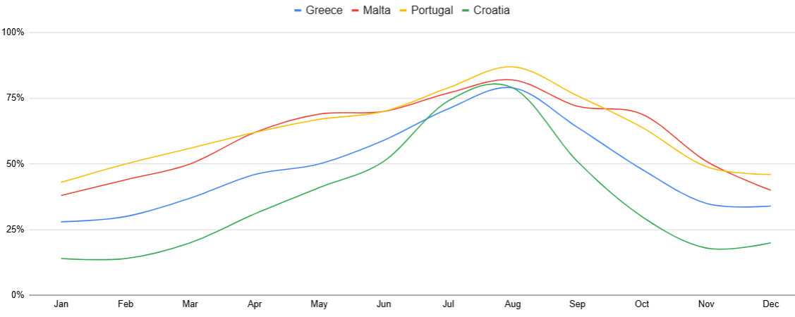
Past occupancy: 2024 vs 2023
Comparison between Greece, Portugal, Malta & Croatia
PriceLabs data, January 2025 (EURO) Excludes private rooms

Slide 9
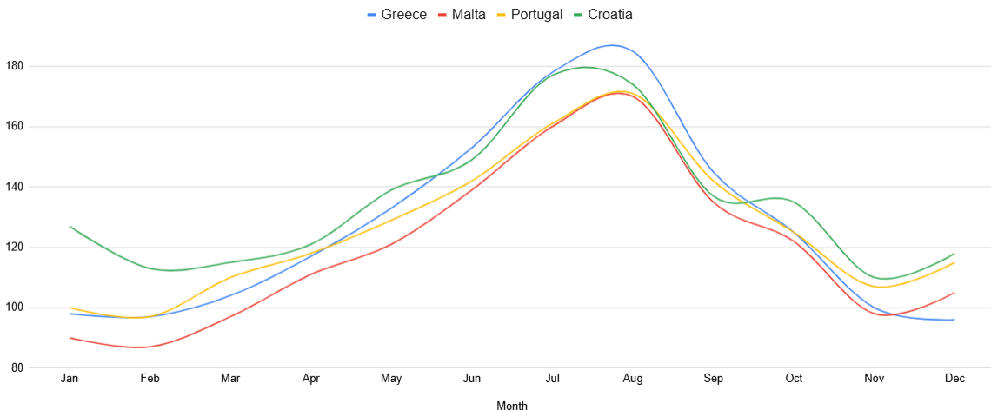
Past ADR: 2024 vs 2023
Comparison between Greece, Portugal, Malta & Croatia
PriceLabs data, January 2025 (EURO) Excludes private rooms

Slide 10
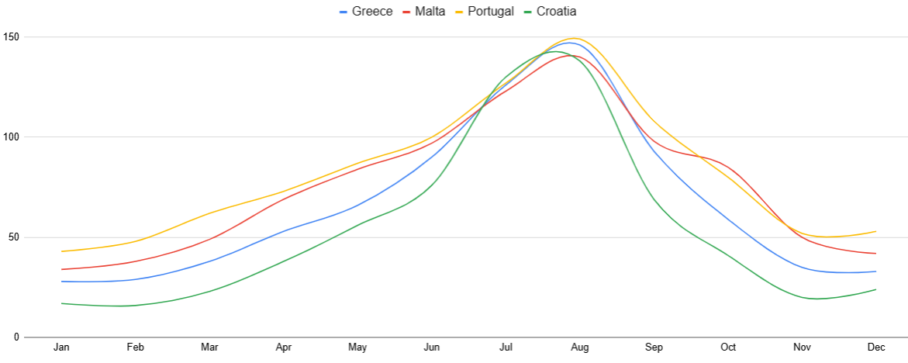
Past RevPAR: 2024 vs 2023
Comparison between Greece, Portugal, Malta & Croatia
PriceLabs data, January 2025 (EURO) Excludes private rooms

Slide 11
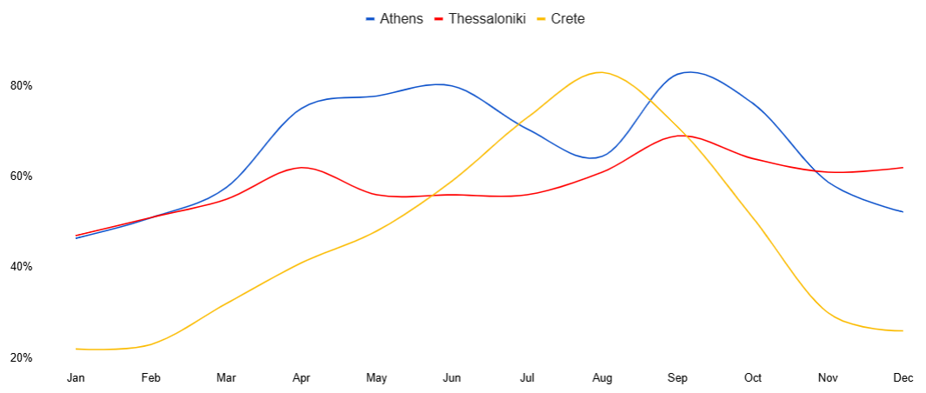
Past occupancy: 2024 vs 2023
Comparison between Athens, Crete & Thessaloniki
PriceLabs data, January 2025 (EURO) Excludes private rooms

Slide 12
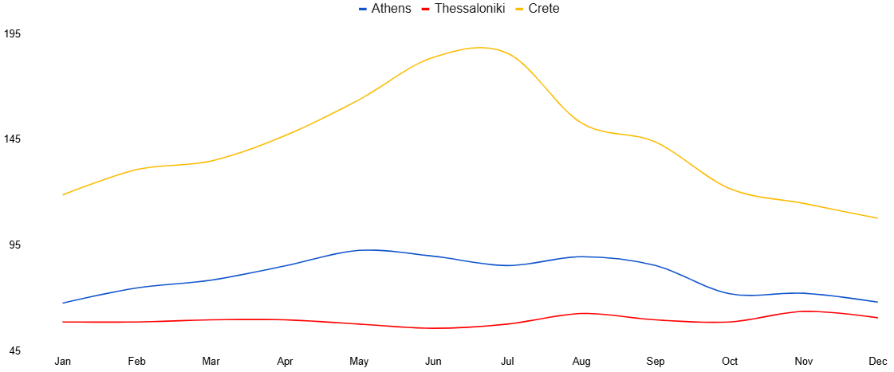
Past ADR: 2024 vs 2023
Comparison between Athens, Crete & Thessaloniki
PriceLabs data, January 2025 (EURO) Excludes private rooms

Slide 13
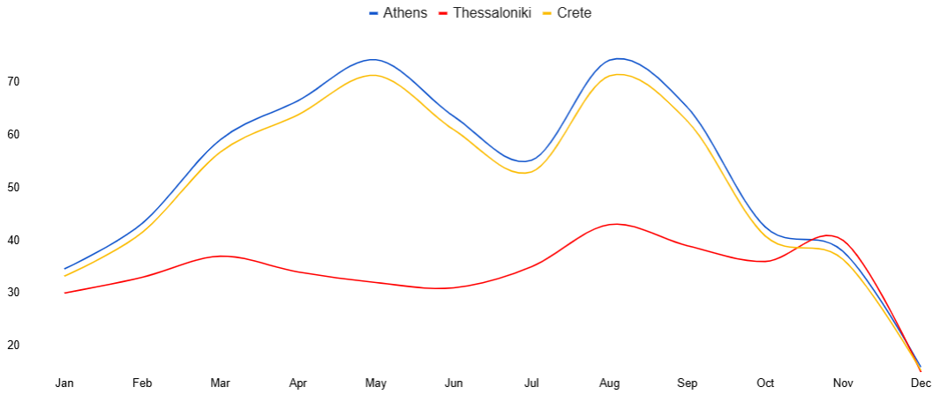
Past RevPAR: 2024 vs 2023
Comparison between Athens, Crete & Thessaloniki
PriceLabs data, January 2025 (EURO) Excludes private rooms

Slide 14
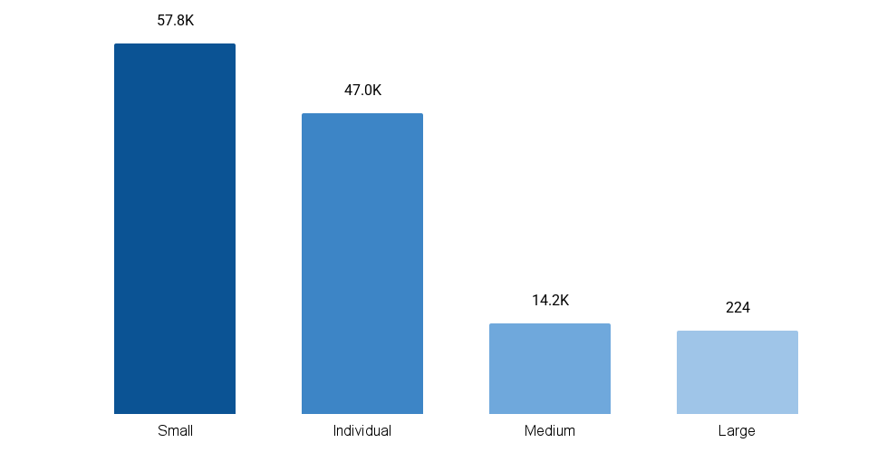
Listing count by host segment for Greece
79% of listings managed by individual and small hosts
Number of listings by host segment
Listings count (%)
44%
Small: 2 - 10 listings
35%
Individual: 1 listing
11%
Medium: 11 - 50 listings
10%
Large: > 50 listings
PriceLabs data, January 2025 (EURO) Excludes private rooms

Slide 15
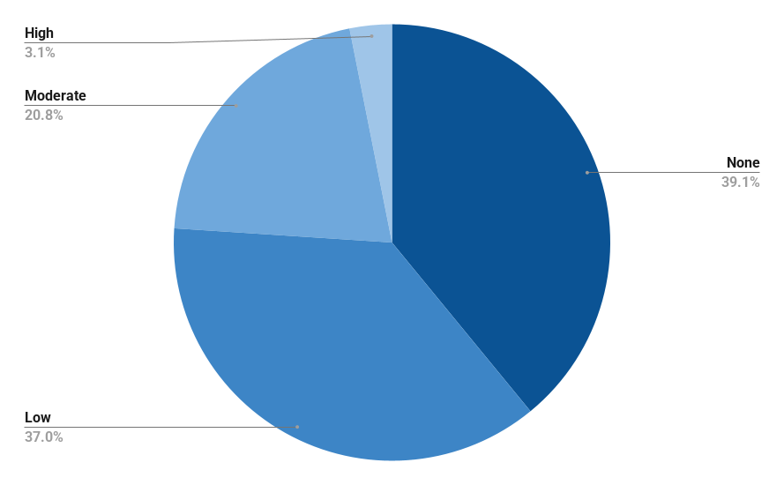
Market share by dynamic pricing (DP) levels for Greece
66% of listings use static and low DP
Listing share by Dynamic Pricing
% listing share across DP levels
1532%
Static pricing
39%
37%
Low: Limited DP
Moderate dynamic pricing
21%
3%
Fully dynamic pricing
None: Static prices
Low: Constant prices with event/holiday adjustments
Moderate: Week-to-week price variations
High: Fully dynamic pricing
PriceLabs data, January 2025 (EURO) Excludes private rooms

Slide 16




Final Insights - Country
Listings increase by 11%, and booked nights rose by 16% over the past 12 months in Greece
Occupancy in Greece is optimal considering ADR & RevPAR. Hosts & PM has potential to maximize revenue with help of Dynamic Pricing
Most listings are managed by small-sized property managers (44%), followed by individual hosts (35%).
65% of listings use static or low DP, showcasing the need to use Dynamic pricing more aggressivley
15
PriceLabs data, January 2025 (EURO) Excludes private rooms

Slide 17
Final Insights - City
Occupancy in Athens was at par with Crete on average while Thessaloniki falls slightly behind
ADR was highest at Crete considering it is an island, followed by Athens and Thessaloniki
RevPAR was highest in Athens, even though the ADR is not the highest, showcasing more potential for maximizing revenue
PriceLabs data, January 2025 (EURO) Excludes private rooms

Slide 18
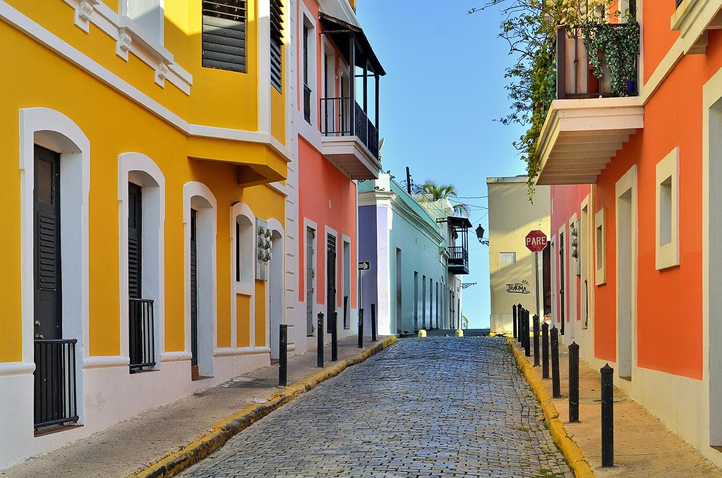
Greece market performance
2023-25

